Slide 1
Clarify Easy Access Tool
Bastin Gomez
26 Nov 2012

Slide 2
Agenda
Clarify – what are the pain points?
The solution – ‘Clarify Easy Access’
Clarify Easy Access Overview

Slide 3
Clarify – what are the pain points?
Clarify is accessible only from a terminal server, which necessitates everybody to access it using remote desktop. This way of doing is very slow
The high volume of incoming tickets makes it very hard to update in real time, hence reports shows a different story than actual situation
Bulk update is not possible with Clarify, i.e., lets say I want to make 20 tickets to 'Service Restored', it needs to be done one by one, which is a huge overhead

Slide 4
The solution – ‘Clarify Easy Access’
A tool named 'Clarify Easy Access' has been developed, which addresses the issues with Clarify
The tool is based on Java Swing framework and can be accessed from anywhere in Amdocs network using JNLP
'Clarify Easy Access' tool works as follows
User types the JNLP link on the browser to launch the application
Once launched, it will identify the user's ntnet login name and it finds out the mapped Clarify username
After these two information is obtained, user can login
Once logged in, all the cases on the user's workgroup is visible in a single window
User can perform 'Bulk Accept' operation, 'Bulk Change Status' operation and 'Bulk Close case' operation
On 'Bulk close case', user will be requested to fill mandatory parameters, if any

Slide 5
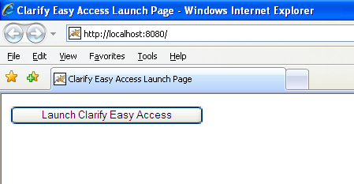
Clarify Easy Access Overview
To launch the tool, just enter the URL on your browser window
A new screen will appear with a button to launch the Tool
Press on the button
Prerequisite: Java 1.6 should be installed on the user pc to run the tool

Slide 6
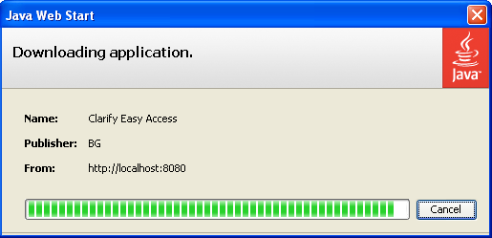
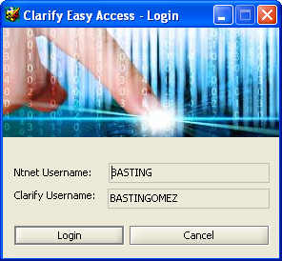
Clarify Easy Access Overview (contd.)
Application will be downloaded from remote
Login window will appear
Ntnet username will be auto-populated
Clarify username will also be auto-populated if the mapping exists, otherwise it will show error message

Slide 7
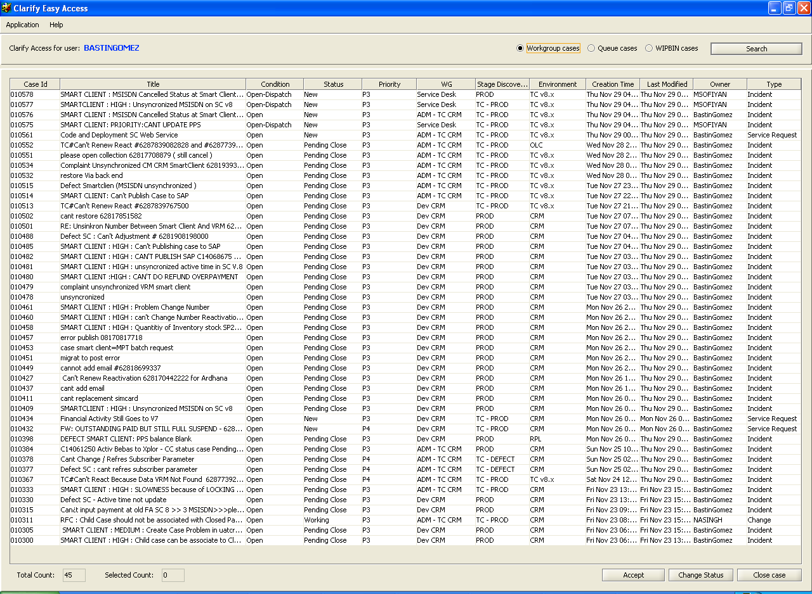
Clarify Easy Access Overview (contd.)
Application screen will appear with the list of all cases from all the WGs of user

Slide 8
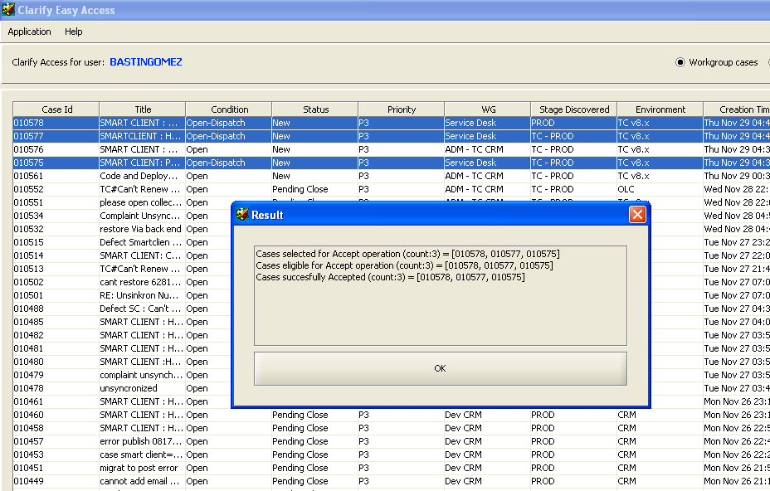
Clarify Easy Access Overview (contd.)
Select multiple rows and click on ‘Accept’ button. It will perform ‘Accept’ operation after checking the eligibility

Slide 9
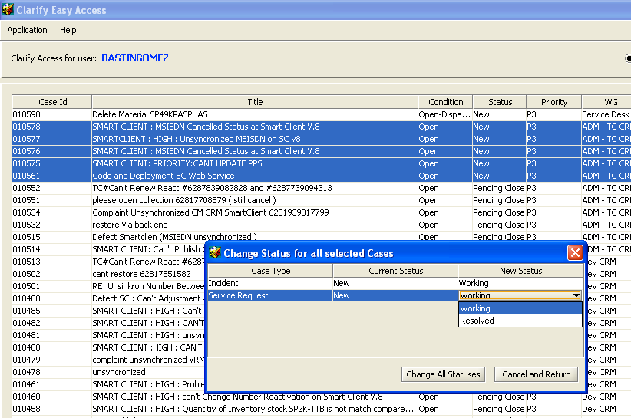
Clarify Easy Access Overview (contd.)
Select multiple rows and click on ‘Change Status’ button.
Choose the new status for all the “Case Type-Current Status” combination
‘Change Status’ operation will be performed for all the selected cases after checking the eligibility.
Status can be changed multiple times, until it becomes ‘Pending Close’

Slide 10
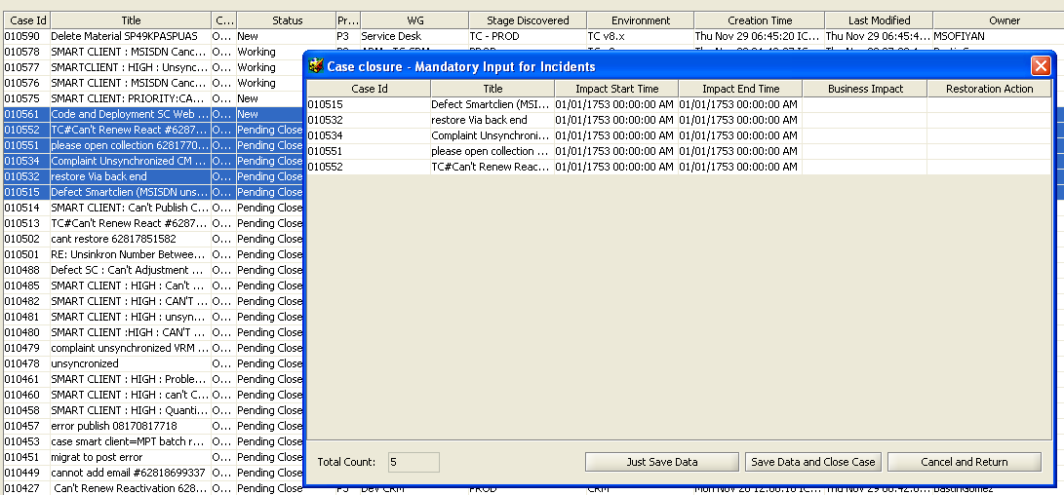
Clarify Easy Access Overview (contd.)
Select multiple rows and click on ‘Close case’ button
All the eligible cases(Pending close) will be closed
If there are any incident cases, another window pops up asking to fill up mandatory fields
Mandatory data can be populated and just saved for future closure or can be directly closed at that point. Closed cases will be removed from main listing

Slide 11
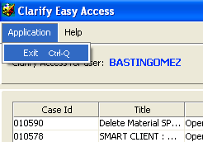
Clarify Easy Access Overview (contd.)
Just press ‘Ctrl – Q’ or select menu ‘Application → Exit’ to exit the application

Slide 12
Clarify Easy Access
Enjoy and Thank you ☺

